Slide 1
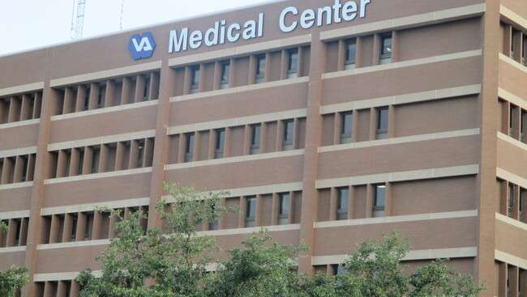
Comprehensive Analysis of Hospital Data

Slide 2
Table of contents
PROBLEM STATEMENT
Introduction to Hospital Data Analysis
Data Cleaning In Power BI
Patient Waiting Time
Visits by Department
Patient Visit By Age
Patient Count By Race
Patient Satisfaction Analysis
Departmental Revenue Evaluation
Month-wise Hospital Visits Visualization
DASHBOAD
CONCLUSION
THANK YOU

Slide 3
PROBLEM STATEMENT
This report aims to analyze a comprehensive hospital dataset using Power BI to uncover insights that can drive improvements in patient care and operational efficiency. Key areas of focus include:
Patient Wait Times and Satisfaction: Assessing the relationship between patient wait times and satisfaction scores to identify areas for improvement.
Departmental Performance: Evaluating the number of visits by department, revenue generation, and appointment fees to understand which departments are most utilized and financially viable.
Demographic Analysis: Analyzing patient visits by age group and race to identify trends and potential disparities in healthcare access and satisfaction.
Resource Allocation: Providing insights into the performance of individual doctors and departments to inform hiring decisions and shift scheduling.

Slide 4
Introduction to Hospital Data Analysis
Focus on leveraging Power BI for comprehensive data insights.
Key areas of analysis include
Data Cleaning: Ensuring data integrity by handling missing values and standardizing formats.
Patient Waiting Times: Analyzing average wait times, currently at 35.26 minutes, to identify areas for operational improvement.
Department Visits: Evaluating total visits across departments to understand patient distribution and demand.

Slide 5
Data Cleaning in Power BI
Load Datasets: Begin by importing the necessary datasets, such as Doctor_Patients_Data and Hospital_ER, into Power BI using the "Get Data" option from the "Home" tab.
Open Power Query :Access the Power Query Editor by selecting "Transform Data" under the "Home" tab, where all data transformation and cleaning tasks will be performed.
Handle Missing Values :Inspect each column for missing values. For instance, replace null values in the patient satisfaction score with 0 and fill any missing Doctor Names with "Unknown" to maintain data integrity.
Standardize Text Fields :Ensure consistency in text fields by applying formatting options. For example, standardize patient_race and department_referral columns to "Capitalize Each Word" to facilitate accurate grouping and filtering.
Apply and Load Changes :After completing the cleaning steps, click "Close & Apply" to save and load the cleaned data back into Power BI, making it ready for further analysis and visualizations.

Slide 6
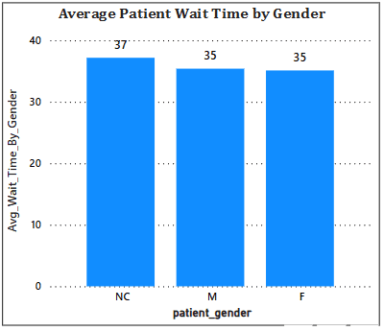
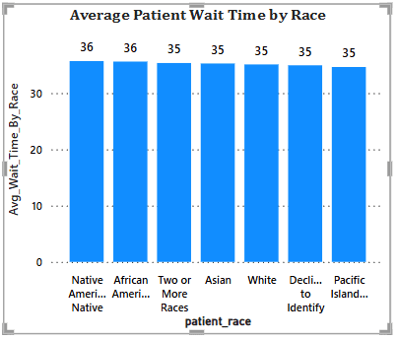
Patient Waiting Time
Insights Gained
Identified overall average wait times across departments.
Native American and African American have most waiting time.
Male and Female have same waiting time.
Highlights areas needing improvement based on departmental comparisons.
Offers opportunities for operational enhancements to reduce wait times.
The average patient wait time in the hospital's ER is calculated to be 35.26 minutes.

Slide 7
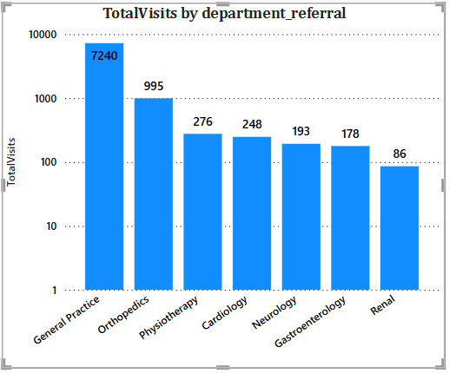
Visits by Department Referral
The total number of visits recorded to date amounts to 9,216.
A column chart visualization displays total visits by department, highlighting areas with high patient demand.
Departments such as General Practice and Orthopedics show significant patient traffic, indicating a need for additional resources.
The analysis reveals referral patterns that can inform staffing and resource allocation decisions.

Slide 8
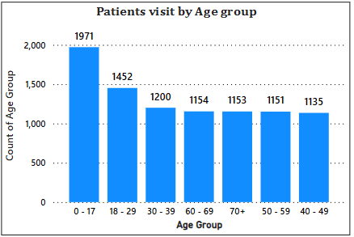
Patient Visits by Age Group
High-utilization demographics are identified, with 0-17 age groups showing significant visit counts, indicating peak demand for healthcare services.
Targeted services can be developed for higher-utilization age groups, ensuring resources are allocated effectively to meet patient needs and promote preventive care opportunities.
Patient visits are segmented into distinct age groups: "0-17", "18-29", "30-39", "40-49", "50-59", "60-69", and "70+".

Slide 9
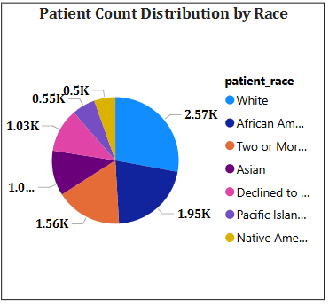
PATIENT COUNT BY RACE
This Pie graph shows dynamic of patients of different ethnicity.
Most of the patient are white.
Least patients are of african american.
Data is denoting count of patient in thousand.

Slide 10
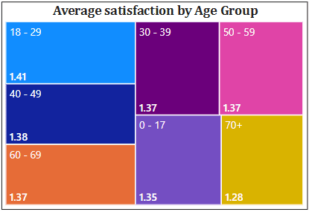
Patient Satisfaction Analysis
Strengths: High satisfaction scores among younger patients (age group 18-29) with an average score of 1.41, indicating effective engagement and service delivery for this demographic.
Weaknesses: The 70+ age group reports the lowest average satisfaction score at 1.28, suggesting potential gaps in service quality or communication that need to be addressed to enhance their experience.
Opportunities: Tailored initiatives aimed at improving the experience for older patients could lead to increased satisfaction scores, fostering loyalty and better health outcomes.
Threats: Persistent low satisfaction scores among older patients may lead to negative perceptions of the hospital, potentially impacting patient retention and overall reputation if not addressed promptly.

Slide 11
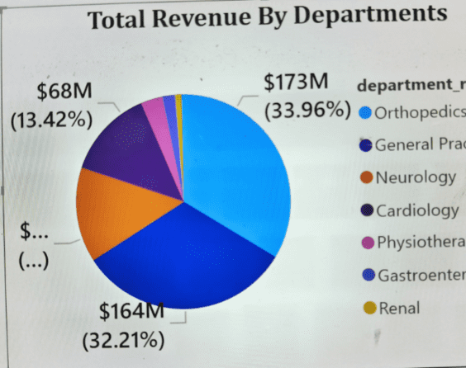
Departmental Revenue Evaluation
Highlights the distribution of revenue across various departments.
Identification of high-performing departments such as General Practice and Orthopedics.
Recognition of departments with lower revenue, indicating potential areas for improvement.
Insights on resource allocation based on revenue generation.
Strategic growth opportunities for departments with lower revenue to enhance financial performance.

Slide 12
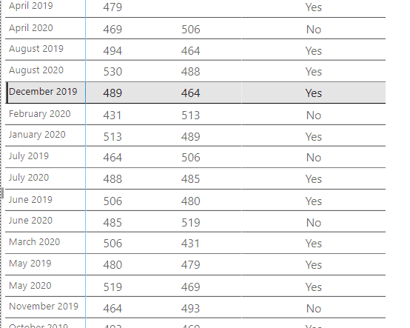
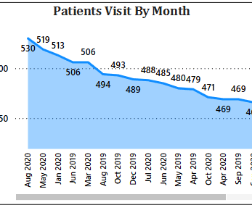
Month-wise Hospital Visits Visualization
A tabular visualization displays the total number of hospital visits recorded each month, providing a clear overview of patient traffic trends.
The table includes a column for previous month visits, allowing for direct comparisons to assess growth or decline in patient visits over time.
An additional column indicates whether the current month's visits have increased compared to the previous month, highlighting months of significant patient demand.
Analysis of the data reveals seasonal trends in patient visits, informing resource allocation and strategic planning for staffing and services.

Slide 13
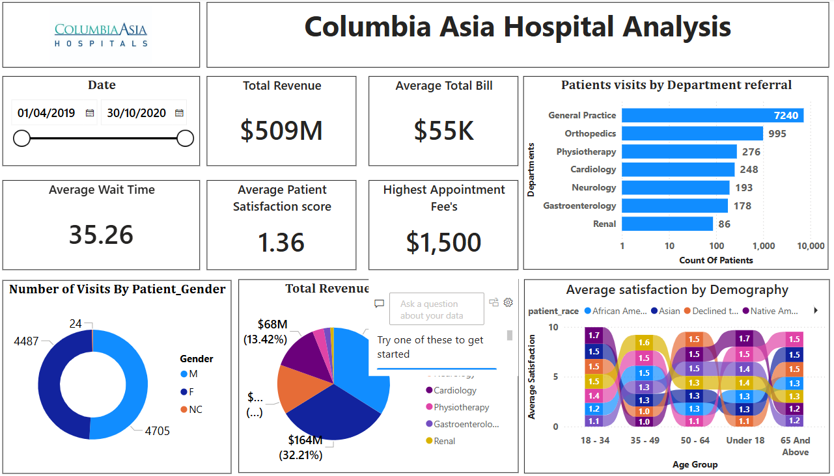

Slide 14
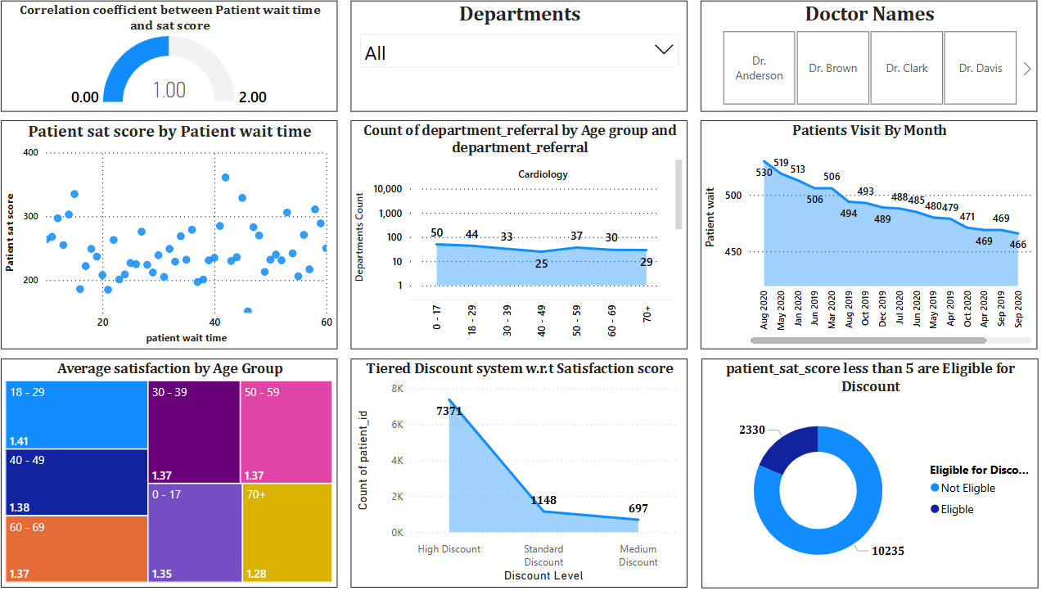

Slide 15
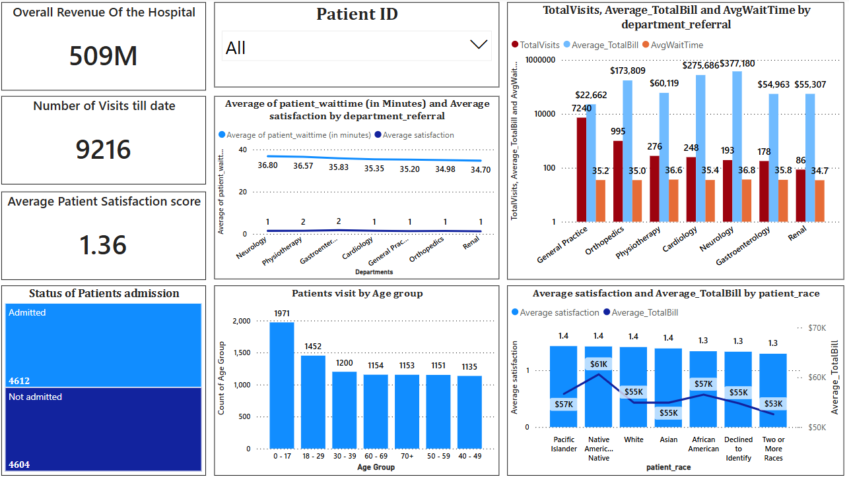

Slide 16
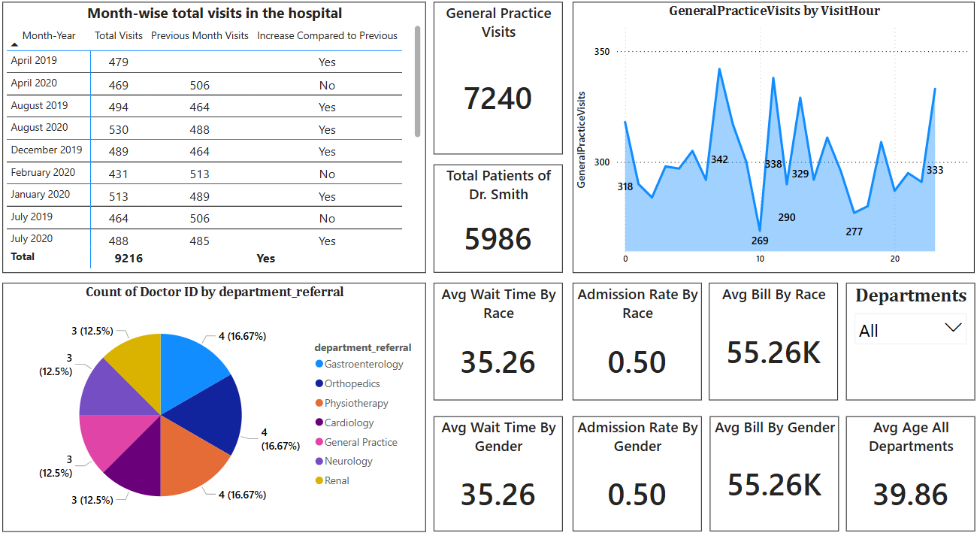

Slide 17
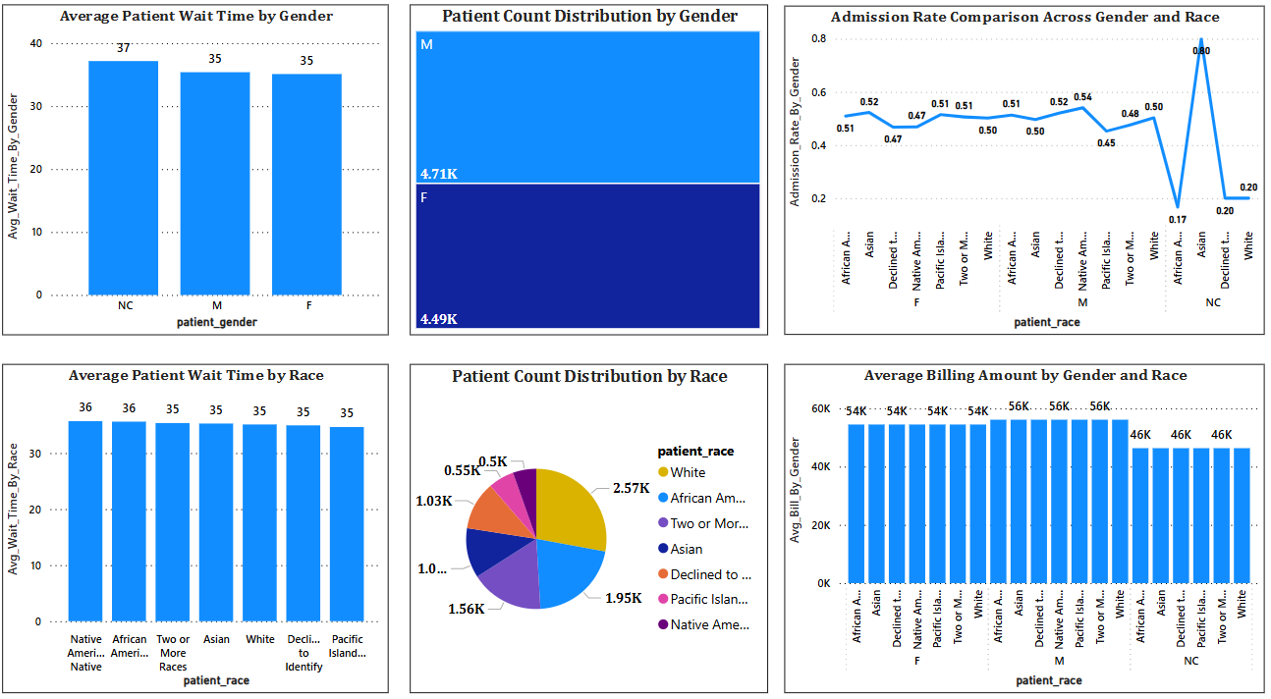

Slide 18
Conclusion
Patient Waiting Time: Analysis revealed that departments like Neurology and Orthopedics have longer average wait times, indicating a need for additional staffing to enhance service efficiency.
Departmental Analysis:High patient demand was identified in General Practice and Neurology, suggesting strategic hiring in these areas to manage patient flow and improve overall care.
Satisfaction Insights: The examination of patient satisfaction scores highlighted demographic trends, with older patients reporting lower satisfaction, pointing to areas for targeted improvement.
Revenue Evaluation: Neurology and Cardiology departments emerged as key revenue generators, emphasizing the importance of resource allocation to maximize financial contributions while maintaining patient care quality.

Slide 19
THANK YOU

